Slide 1
FINAL PROJECT CALCULATOR

Slide 2
TEAM MEMBERS
DULSHAN WELENGODA
MARK FERNANDO
VISAL SAMARAKOON
SHEHARA PARIS

Slide 3
PERFORMANCE OF TEAM MEMBERS
Dulshan Welengoda
Project Planning, Task Assigning, Task Monitoring, And Development
Mark Fernando
Project Planning,Meeting Arrangements, Development, And Task Monitoring
Visal Samarakoon
Project Planning, Meeting Arrangements ,And Task Monitoring
Shehara Paris
Project Documentation, Meeting Minutes Taking, Task Monitoring

Slide 4
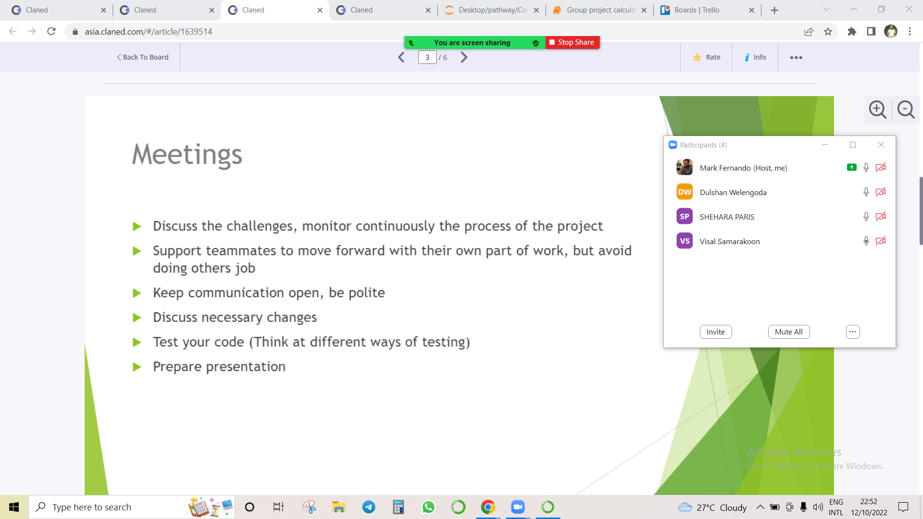
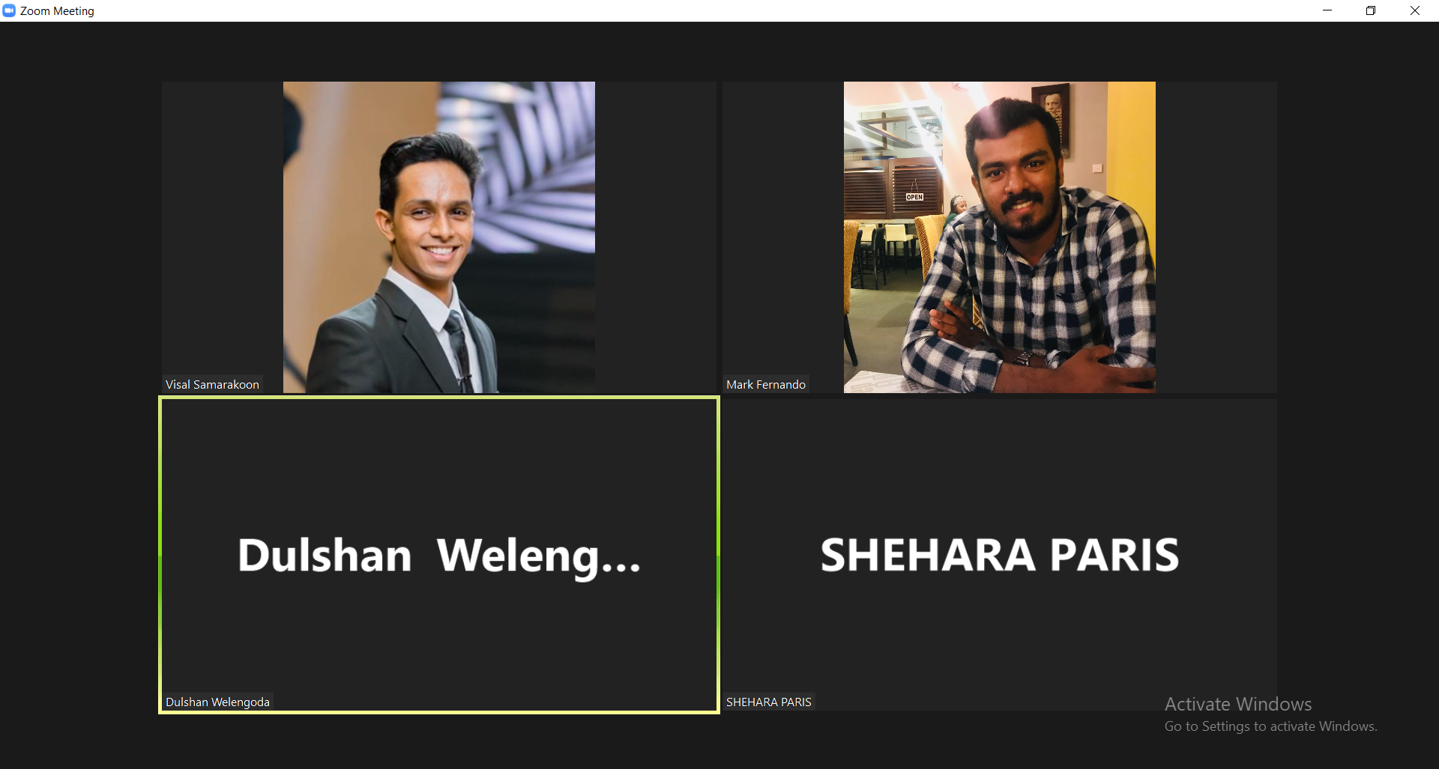
1) Why we choose it?
We have chosen to develop a basic calculator since this might be helpful for us in using mathematical operators in Python programming in future assignments, tasks…etc.
2) Version controlling used?
We have used GitHub in managing the version in developing the code.
3) Meetings held?
The project team had several meetings to:
Select the project topic
Task and assignments
Review the work in progress
Prepare the presentations and fine-tune the needful

Slide 5
PROJECT DESCRIPTION
This is a basic calculator program developed using the python language
Designed for several mathematical operations
User has the right to choose operations
We used GitHub for source code hosting and version controlling
Jupyter Notebook was used for coding

Slide 6
CODE STRUCTURE
Components use for the code
Modules
Loops
Functions
Logical statements

Slide 7
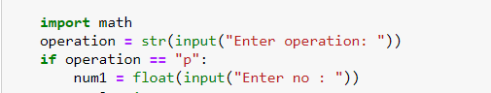
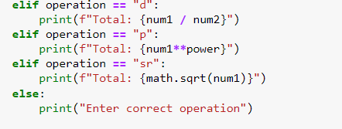
MODULES

Slide 8
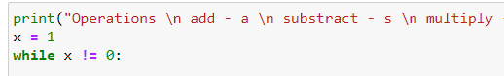
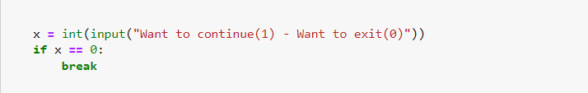
While Loop

Slide 9
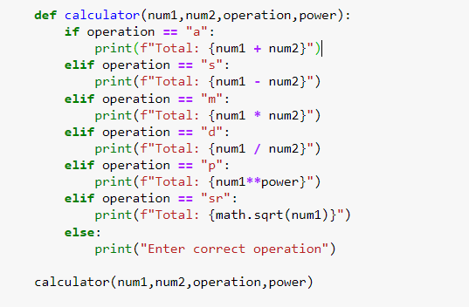
Function

Slide 10
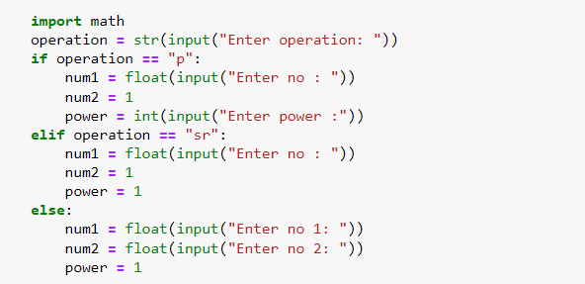
If else Statement

Slide 11
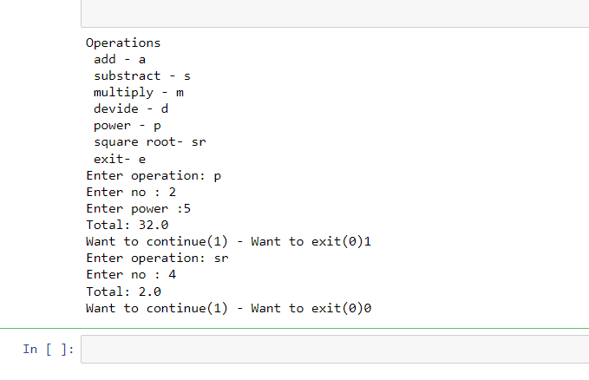
Result

Slide 12
EVALUATION & CONCLUSION
We have successfully managed to develop a basic calculator.
However, we are planning to incorporate a GUI (Graphical User Interface) into this project to make it more convenient for the user in the future.

Slide 13
THANK YOU!

